Slide 1

AI-Enabled Acoustic Detection & Early Warning System for Red Palm Weevil Infestation in Coconut Trees
Group No: Team 13 Category: Research-Product-Software
COLLABORATOR
FACULTY GUIDE
[ Collaborator Name ], [ Affiliation ]
Dr. T. Senthil Kumar, Professor, CSE Department
TEAM MEMBERS
Roll No | Name | Photo | Email ID | Mobile No | GitHub URL
 | [ Member Name ]
LinkedIn Product Demo: [URL] GitHub Repository: [URL]
This presentation is prepared for Course / Project / Hackathon / Industry Demo
If course specify the course code-Name
2

Slide 2
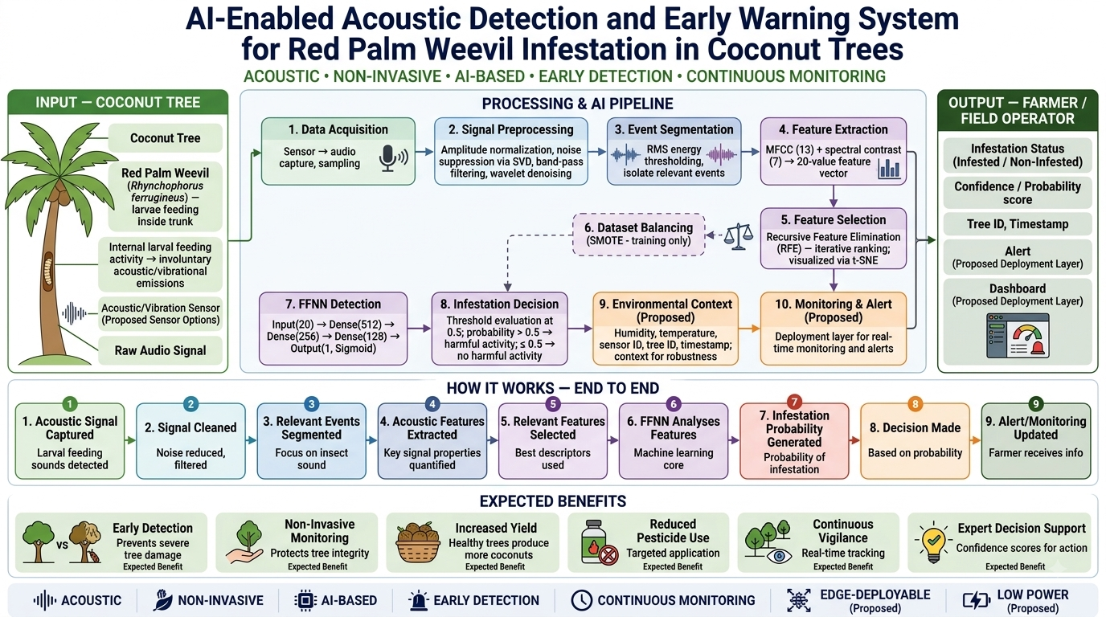
Problem Statement:
Architecture diagram:
The Red Palm Weevil (Rhynchophorus ferrugineus) is the most destructive pest of coconut and palm trees worldwide. Its larvae feed hidden inside the trunk, so early damage is invisible and symptoms such as yellowing fronds and crown collapse appear too late. Manual inspection is slow and unreliable across large plantations — yet curative treatment works only if the weevil is caught early.
Objective:
Detect Red Palm Weevil infestation early and non-invasively by capturing the faint acoustic / vibrational signals of larvae feeding inside the trunk and classifying them with a lightweight neural network.
Sub-Objectives:
Capture larval feeding sound using an acoustic / vibration sensor
Preprocess and segment the signal — noise removal, 1–8 kHz band-pass, RMS event isolation
Extract features: 13 MFCC + 7 spectral-contrast → 20-value vector
Classify with a lightweight FFNN (512→256→128→1) against a 0.5 threshold
Trigger alerts and continuous monitoring for field operators
3

Slide 3
Similar Products in the Same Area:
Product Name | URL | Features | Limitation
Agrint IoTree |  | Seismic sensor placed per tree; automated signature detection with false-alarm filtering (IoT + mobile app). | One sensor per tree — hardware cost scales with plantation size; primarily date-palm oriented.
AED2000 / LAAR WD-60 |  | Handheld piezoelectric acoustic probe; larval activity interpreted by a human listener via headphones. | Manual and expertise-dependent; not continuous, not automated, impractical at scale.
KAUST Fiber-Optic DAS |  | Distributed fiber-optic acoustic sensing across trees with a CNN classifier (~97% reported accuracy). | Research-stage; needs specialised fiber-optic infrastructure — not low-cost or field-simple.
4

Slide 4
Abstract of Product:
A non-invasive acoustic early-warning system that detects Red Palm Weevil larvae feeding hidden inside coconut trunks — capturing their faint feeding sounds and classifying them with a lightweight feed-forward neural network to flag infestation early, before damage becomes visible, and continuously across a plantation.
Novelty:
1
State of the Art
2
Product
3
Product Features
4
Research Gap Focused
Acoustic RPW detection established in literature since ~2010
Baseline MFCC + spectral-contrast + FFNN pipeline: 85.6% accuracy, F1 = 0.72
Commercial systems exist (e.g. Agrint IoTree) — mostly date-palm focused
Reproducible acoustic-FFNN detector validated on our own coconut field data
Extended into an edge / IoT early-warning system with dashboard and alerts
Proposed agentic orchestration layer around the trained detector
Non-invasive and early
Lightweight FFNN: 176k params, 1.51 MB, 29.4 ms inference
Continuous monitoring and field alerts
Confidence-aware decision output
Reduces targeted pesticide use
Robustness to environmental noise (wind, rain, birds)
Continuous monitoring absent in the baseline
Real-time, low-power edge deployment
Actionable output for field operators
Confidence-aware 3-class decision + feedback loop
5

Slide 5
Member Contributions
Technical contribution of each team member
Member Name | Contribution (Technical)
[ Member Name ] | [ Describe specific technical contribution]
6

